Slide 1













Feed forward
Input layer
hidden layer
output layer
$$W^{(2)}$$
$$W^{(3)}$$
계산된 Loss function값이
최소인가?
$$A1⋅W^{2}+b^{2}$$
$$A2⋅W^{3}+b^{3}$$
Training Data Set
X , T
Y
$$A1$$
$$Z2$$
$$Z3$$
$$relu(Z2)$$
$$softmax(Z3)$$
$$A2$$
$$A3$$
NO
$$b^{(2)}$$
$$b^{(3)}$$
Optimizer를 이용한 Weight, bias 업데이트

Slide 2


Feed forward
Input layer
hidden layer
output layer
$$W^{(2)}$$
$$W^{(3)}$$
계산된 Loss function값이
최소인가?
$$A1⋅W^{2}+b^{2}$$
$$A2⋅W^{3}+b^{3}$$
Training Data Set
X , T
Y
$$A1$$
$$W_{h}$$
$$tanh$$
$$softmax(Z3)$$
$$A2$$
$$A3$$
NO
$$b^{(2)}$$
$$b^{(3)}$$
Optimizer를 이용한 Weight, bias 업데이트

Slide 3
Input layer
hidden layer
output layer
대명사 | 0.97
명사 | 0.01
동사 | 0.01
전치사 | 0.01
I
linear
regression
tanh
linear
regression
softmax
처음에는 이전 데이터 없음
Input layer
hidden layer
output layer
대명사 | 0.02
명사 | 0.21
동사 | 0.75
전치사 | 0.02
work
linear
regression
tanh
linear
regression
I
softmax
기억된 이전데이터인 I 가 영향을 미침
Input layer
hidden layer
output layer
대명사 | 0.01
명사 | 0.01
동사 | 0.01
전치사 | 0.97
at
linear
regression
tanh
linear
regression
work
softmax
I 에 영향을 받은 work 이 영향을 미침

Slide 4











Feed forward
Input layer
hidden layer
output layer
$$W_{ih}$$
$$W_{ho}$$
계산된 Loss function값이
최소인가?
$$A1⋅W_{ih}+b_{h}$$
$$A2⋅W_{ho}+b_{o}$$
Training Data Set
X , T
Y
$$Z2$$
$$A1$$
$$Z3$$
$$R2$$
$$W_{hh}$$
$$H$$
$$tanh⁡(R2)$$
$$softmax(Z3)$$
$$A2$$
$$A3$$
NO
$$b_{h}$$
$$b_{o}$$
Optimizer를 이용한 Weight, bias 업데이트

Slide 5









$$y_{t−2}$$
output
$$y_{t−1}$$
output
$$y$$
output
RNN
RNN
RNN
$$Σ$$
$$Σ$$
$$Σ$$
$$x_{t−2}$$
input
$$x_{t−1}$$
input
$$x$$
input

Slide 6
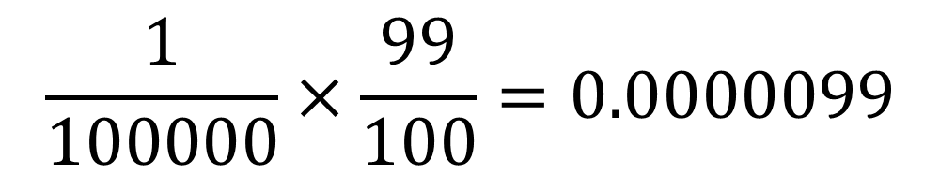
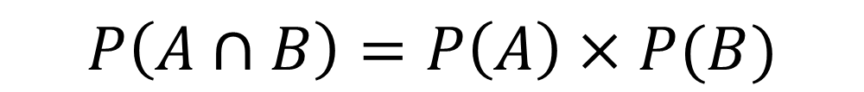
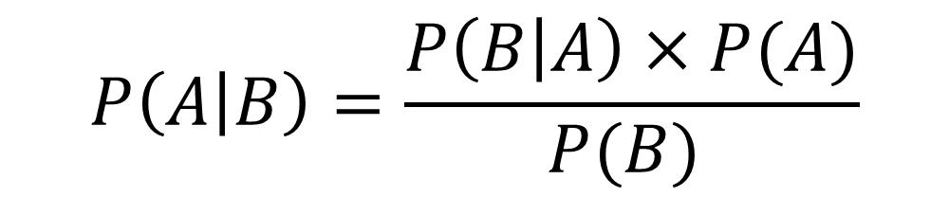
$$P\left(A∩B\right)=P\left(A\right)×P(B)$$
$$\frac{1}{100000}×\frac{99}{100}=0.0000099$$
$$P\left(A | B\right)=\frac{P\left(B | A\right)×P(A)}{P(B) }$$
$$P\left(rare disease | positive result\right)=\frac{P\left(positive result | rare disease\right)×P(rare disease)}{P(positive result) }$$
$$P\left(spam | ′대출^{′}이 포함된 메일 \right)=\frac{P\left(대출^{′}이 포함된 메일 | spam\right)×P(spam)}{P(′대출^{′}이 포함된 메일) }$$

Slide 7
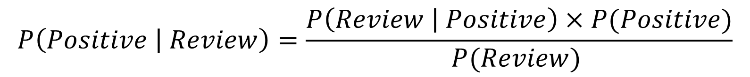
$$P\left(Positive | Review\right)=\frac{P\left(Review | Positive\right)×P(Positive)}{P(Review) }$$
$$P\left("침대가 정말 부드럽다" | Positive\right)=P("침대가" | Positive)×P(＂정말＂ | Positive)×P("부드럽다＂ | Positive)$$

Slide 8
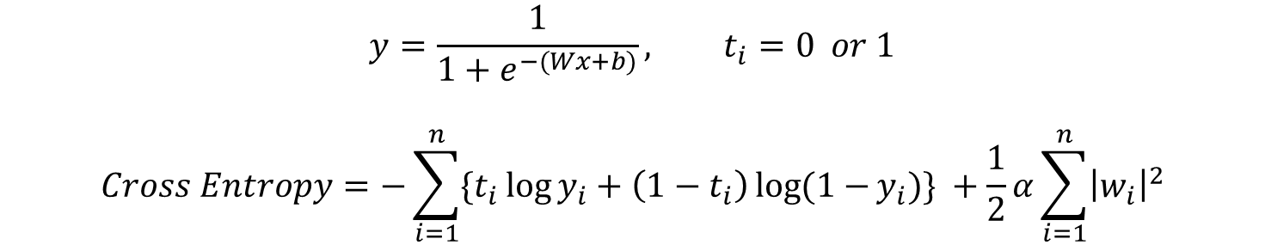
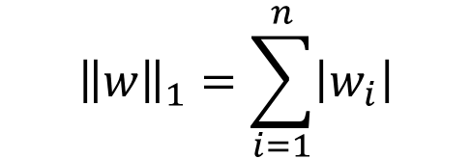
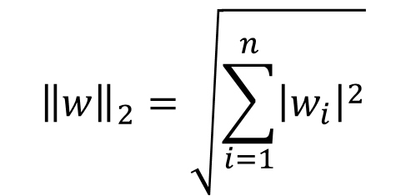
$${\left\|w\right\|}_{2}=\sqrt{\sum_{i=1}^{n}{{\left|w_{i}\right|}^{2}}}$$
$${\left\|w\right\|}_{1}=\sum_{i=1}^{n}{\left|w_{i}\right|}$$
$$y=\frac{1}{1+e^{−(Wx+b)}}, t_{i}=0 or 1$$
$$Cross Entropy=−\sum_{i=1}^{n}{\{t_{i}\log{y_{i}}+\left(1−t_{i}\right)\log{(1−}y_{i})\}} +\frac{1}{2}α\sum_{i=1}^{n}{{\left|w_{i}\right|}^{2}}$$

Slide 9

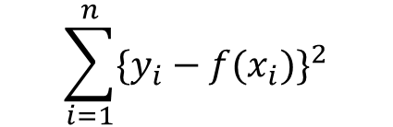
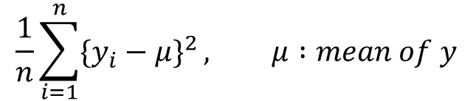
$$\sum_{i=1}^{n}{{\{y_{i}−f(x_{i})\}}^{2}}$$
$$\frac{1}{n}\sum_{i=1}^{n}{{\{y_{i}−μ\}}^{2}}, μ :mean of y$$
$$loss function, E(W,b)=\frac{1}{n}\sum_{i=1}^{n}{{[t_{i}−{(Wx}_{i}+b)]}^{2}}$$

Slide 10


















Input layer
hidden layer
output layer
Training Data Set
linear
regression
tanh
linear
regression
출력값
softmax
$$Y_{t−1}$$
$$Y_{t}$$
$$Y_{t+1}$$
output
output
output
$$W_{ho}$$
$$W_{ho}$$
$$W_{ho}$$
$$W_{hh}$$
$$W_{hh}$$
$$W_{hh}$$
$$H_{t−1}$$
$$H_{t}$$
$$H_{t+1}$$
tanh
tanh
tanh
$$W_{ih}$$
$$W_{ih}$$
$$W_{ih}$$
$$X_{t−1}$$
$$X_{t}$$
$$X_{t+1}$$

Slide 11


H = 1
xdata
ydata
W=3, h=1
학습데이터
xdata | Ydata
[10, 12, 9] | 11
[12, 9, 11] | 16
… | …
10
12
9
11
16
7
25
$$⋯$$
W = 3
H = 2
xdata
ydata
W=3, h=2
학습데이터
xdata | Ydata
[10, 12, 9] | 16
[12, 9, 11] | 7
… | …
10
12
9
11
16
7
25
$$⋯$$
W = 3

Slide 12


















MSE 계산
$$Y_{t−1}$$
$$Y_{t}$$
$$Y_{t+1}$$
정답 : 4.0
output
output
output
$$W_{ho}$$
$$W_{ho}$$
$$W_{ho}$$
$$W_{hh}$$
$$W_{hh}$$
$$W_{hh}$$
$$H_{t−1}$$
$$H_{t}$$
$$H_{t+1}$$
tanh
tanh
tanh
$$W_{ih}$$
$$W_{ih}$$
$$W_{ih}$$
$$1.0$$
$$2.0$$
$$3.0$$

Slide 13
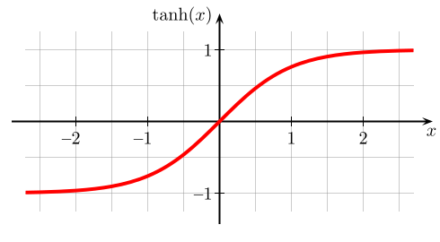

$$H_{t−1}=tanh⁡(H_{t−2}W_{hh}+X_{t−1}W_{ih})$$
$$H_{t}=tanh⁡(H_{t−1}W_{hh}+X_{t}W_{ih})$$
$$H_{t+1}=tanh⁡(H_{t}W_{hh}+X_{t+1}W_{ih})$$

Slide 14






$$H_{t−1}$$
$$H_{t}$$
$$H_{t+1}$$
tanh
tanh
tanh
$$X_{t−1}$$
$$X_{t}$$
$$X_{t+1}$$

Slide 15








$$H_{t−1}$$
$$H_{t}$$
$$C_{t−1}$$
$$C_{t}$$
tanh
tanh
sigmoid
sigmoid
tanh
sigmoid
sigmoid
sigmoid
tanh
sigmoid
$$H_{t−1}$$
$$H_{t}$$
$$X_{t−1}$$
$$X_{t}$$

Slide 16












$$H_{t−1}$$
forget
input
output
$$H_{t}$$
$$H_{t+1}$$
$$C_{t−1}$$
$$C_{t}$$
$$C_{t+1}$$
tanh
t - 1
lstm
layer
t + 1
lstm
layer
sigmoid
sigmoid
tanh
sigmoid
$$H_{t−1}$$
$$H_{t}$$
$$H_{t+1}$$
$$X_{t−1}$$
$$X_{t}$$
$$X_{t+1}$$

Slide 17












$$H_{t}$$
$$C_{t}$$
$$C_{t−1}$$
tanh
$$F_{t}$$
$$I_{t}$$
$$\tilde{C_{t}}$$
$$O_{t}$$
sigmoid
sigmoid
tanh
sigmoid
$$W_{f}$$
$$H_{t−1}$$
$$U_{f}$$
$$H_{t}$$
$$X_{t}$$
$$F_{t}=sigmoid\left(U_{f}X_{t}+W_{f}H_{t−1}+b_{f}\right)$$

Slide 18














$$H_{t}$$
$$C_{t}$$
$$C_{t−1}$$
tanh
$$F_{t}$$
$$I_{t}$$
$$\tilde{C_{t}}$$
$$O_{t}$$
sigmoid
sigmoid
tanh
sigmoid
$$W_{in}$$
$$W_{c}$$
$$H_{t−1}$$
$$U_{in}$$
$$U_{c}$$
$$H_{t}$$
$$X_{t}$$
$$\tilde{C_{t}}=tanh\left(U_{c}X_{t}+W_{c}H_{t−1}+b_{c}\right)$$
$$I_{t}=sigmoid\left(U_{in}X_{t}+W_{in}H_{t−1}+b_{in}\right)$$

Slide 19
$$H_{t}$$
$$C_{t}$$
$$C_{t−1}$$
tanh
$$F_{t}$$
$$I_{t}$$
$$\tilde{C_{t}}$$
$$O_{t}$$
sigmoid
sigmoid
tanh
sigmoid
$$H_{t−1}$$
$$H_{t}$$
$$X_{t}$$
$$C_{t}=F_{t}C_{t−1}+I_{t}\tilde{C_{t}}$$

Slide 20


$$H_{t}$$
$$C_{t}$$
$$C_{t−1}$$
tanh
$$F_{t}$$
$$I_{t}$$
$$\tilde{C_{t}}$$
$$O_{t}$$
sigmoid
sigmoid
tanh
sigmoid
$$W_{o}$$
$$H_{t−1}$$
$$U_{o}$$
$$H_{t}$$
$$X_{t}$$
$$H_{t}=O_{t}×tanh⁡(C_{t})$$
$$O_{t}=sigmoid(U_{o}X_{t}+W_{o}H_{t−1}+b_{o})$$

Slide 21
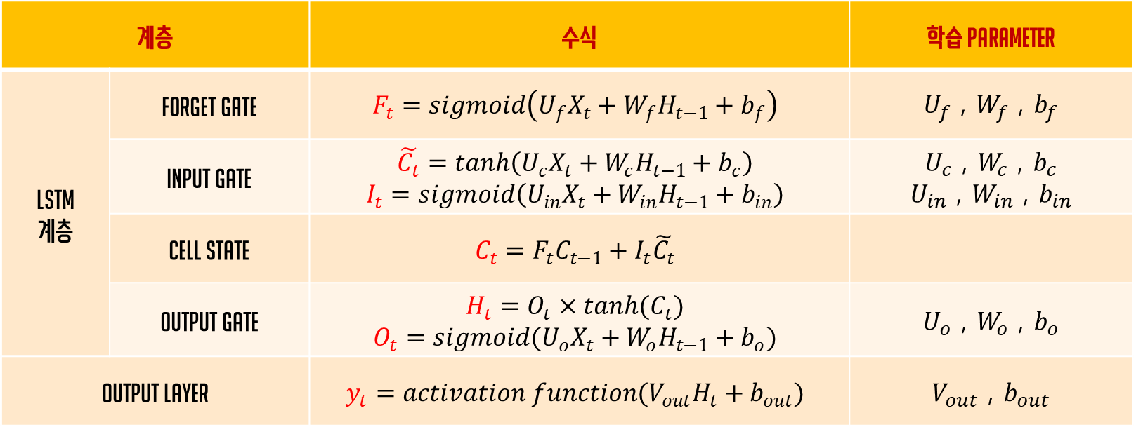
계층 |  | 수식 | 학습 Parameter
LSTM 계층 | Forget gate | $$F_{t}=sigmoid\left(U_{f}X_{t}+W_{f}H_{t−1}+b_{f}\right)$$ | $U_{f}$ , $W_{f}$ , $b_{f}$
 | Input gate | $$\tilde{C_{t}}=tanh\left(U_{c}X_{t}+W_{c}H_{t−1}+b_{c}\right)$$ $$I_{t}=sigmoid\left(U_{in}X_{t}+W_{in}H_{t−1}+b_{in}\right)$$ | $U_{c}$ , $W_{c}$ , $b_{c}$ $U_{in}$ , $W_{in}$ , $b_{in}$
 | Cell State | $$C_{t}=F_{t}C_{t−1}+I_{t}\tilde{C_{t}}$$
 | Output gate | $$H_{t}=O_{t}×tanh(C_{t})$$ $$O_{t}=sigmoid(U_{o}X_{t}+W_{o}H_{t−1}+b_{o})$$ | $U_{o}$ , $W_{o}$ , $b_{o}$
Output Layer |  | $$y_{t}=activation function(V_{out}H_{t}+b_{out})$$ | $V_{out}$ , $b_{out}$

Slide 22
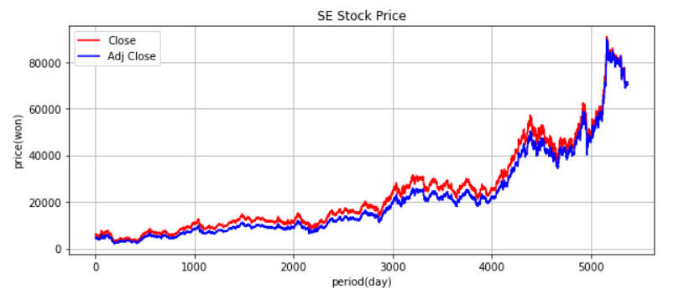
예측
20년간의 주가 데이터 학습

Slide 23


Window size = 40
$$⋯$$
3MA
$$⋯$$
5MA
Adj
close
$$⋯$$
Feature
(입력데이터)
label
(정답데이터)

